Slide 1
GIS for Transport Applications
Dr Nick Bearman, CGeog (GIS)
Department of Geography and Planning
@nickbearmanuk

Slide 2
Outline
11am - Why I need transport routing
Project & my background
11:10am - Using Google Maps API in R
Google Maps API in R
Routing in R
11:45am - Routing and big data (>1000 routes)
Routino on the web and in R
12pm - Presentation of Maps

Slide 3


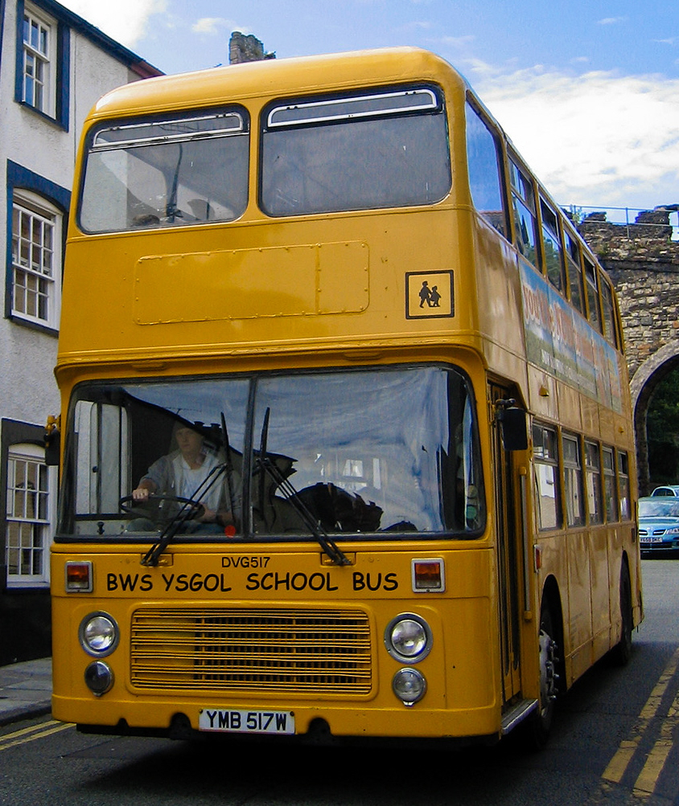
Home to School Travel
About 7.5m school aged children in England
(Most) have to travel from home to school
http://en.wikipedia.org/wiki/File:Alpine_Travel_bus_DVG517_(YMB_517W)_1981_Bristol_VRT_SL3_ECW,_10_July_2006.jpg
D Sharon Pruitt http://www.flickr.com/photos/pinksherbet/234942843/
http://www.flickr.com/photos/bike/8560715649/in/photostream/

Slide 4
Data sources
Pupil Level Annual School Census (2008-2011)
Pupil home postcode
“Usual” mode of travel (11 options)
Data for each year
Home: L11 4SH School: L11 0BP Mode: WLK

Slide 5
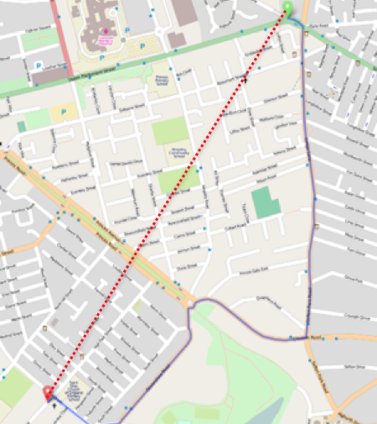
Traditional estimation technique
Euclidean distance
Average emissions values for mode of transport
Straight lines will typically underestimate true distances
No sensitivity to different vehicle types

Slide 6
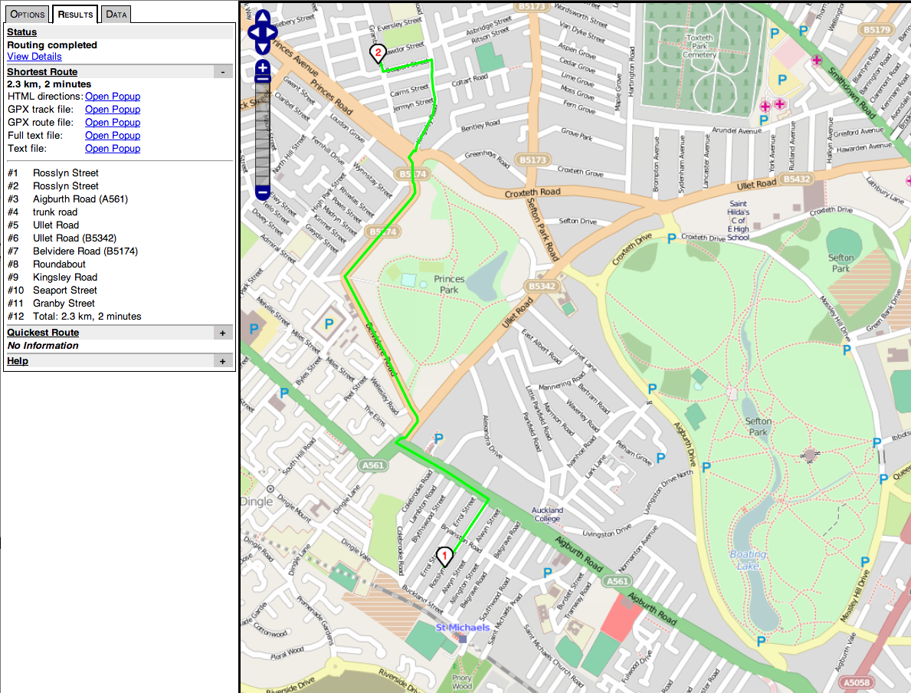
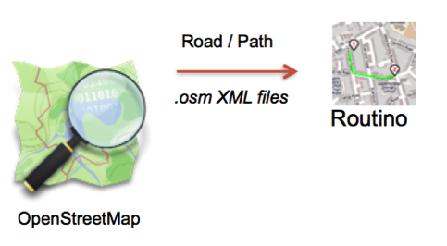
Street network - OpenStreetMap & Routino
Walk, Cycle, Car (+ Car Share), Taxi
Bus (public, school, unknown)
Text file:
Distance
Route

Slide 7
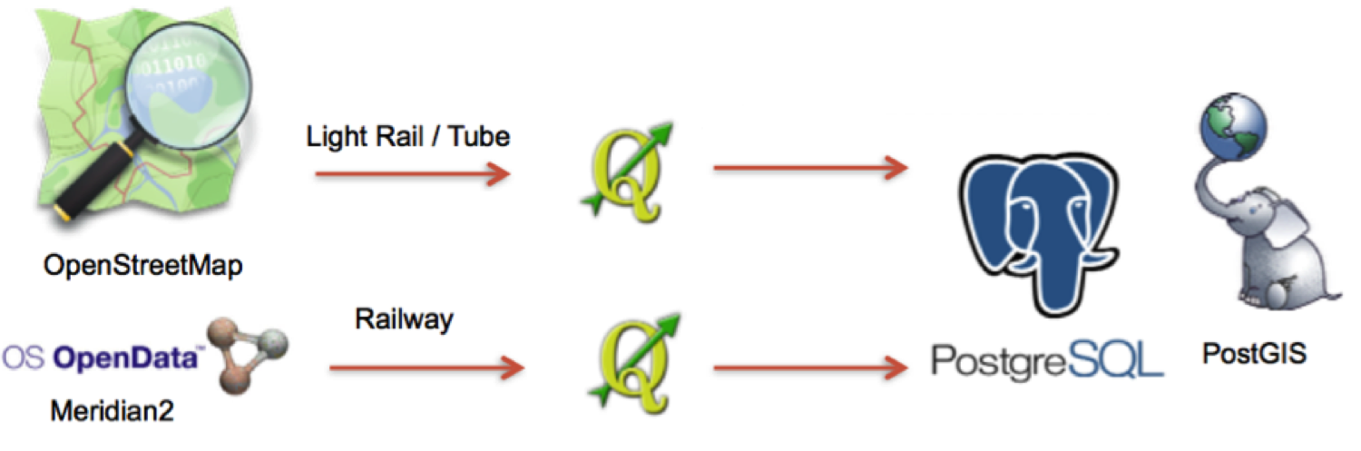

Non-street network - pgRouting
Train, Tram (Metro / Light Rail), Tube
pgRouting

Slide 8
Try the code out in Rstudio!

Slide 9
Routing and Big Data
Home to school project
7.5 million routes
Google Maps API limited to 1000 routes / hour
I needed other options

Slide 10
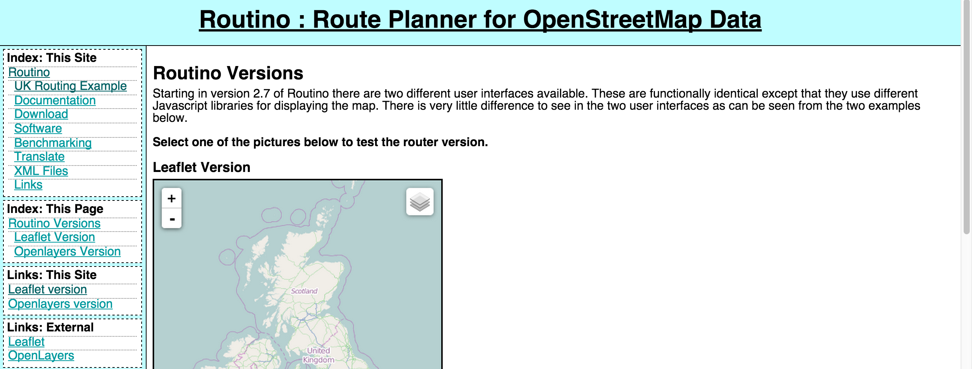
OSM and Routino
Can use OpenStreetMap and Routino
Details at http://www.routino.org/
Can do web-based routing (one off)

Slide 11
OSM and Routino
Or - Run as a program locally
Using OSM data
Routino 2.7
Command line interface
router <origin> <destination> <type> <settings>….
Can run command line from R
Loops
(used OSX i.e. unix-type)

Slide 12
OSM and Routino
R handled data management
Looped through for each record of 7.5 million for each of 4 years
Total run time about 14 days on desktop computer

Slide 13
Try Routino yourself!
www.routnio.org

Slide 14
Many thanks
Questions?

